Slide 1

A Comparative Study of Function Calling in LLMs With a Focus on Fine-Tuning For Precision
Master’s Thesis
Computer Science
Kunjan Ketanbhai Shah
Matr.-Nr. 6961713
Examiners: Herr Prof. Dr.-Ing. Roman Dumitrescu Herr Dr.-Ing. Christian Koldewey Herr M. Eng. Tommy Falkowski Herr M. Sc. Siddhanth Janadri
Paderborn | November 19, 2025
Notes:
“Good morning, everyone.
My name is Kunjan Shah.
Today I will present my master thesis titled ‘A Comparative Study of Function Calling in LLMs With a Focus on Fine-Tuning for Precision.’
I would like to thank my examiners and everyone present for joining.”

Slide 2

Outline
Introduction & Motivation
Research Questions & Objectives
Background
Methodology
Research Findings
Limitations & Future Work
Conclusion
Notes:
“Here is the outline for today’s talk.
I will start with the introduction and motivation.
Then research questions and objectives.
After that, the background.
Then, the methodology, the research findings and finally limitations, future work, and conclusion.”

Slide 3
Introduction & Motivation
1
Notes:
“Let’s start with the introduction and the motivation behind this work.”

Slide 4
Introduction & Motivation
Context
Large Language Models (LLMs) can perform many NLP tasks like code generation, summarization, and Q&A.
They have opened use cases in domains such as education, medicine, and software development.
But they still have key limits: hallucinations and lack of real-time awareness. These issues become serious in AI agents that must act or make decisions.
Retraining LLMs to update knowledge is slow and costly. To overcome such limits, “Function Calling” (“Tool Use” or “Tool Calling”) was first introduced in 2023 by OpenAI.
It allows models to produce structured JSON outputs for better integration with external systems.
Notes:
“Large Language Models today are very powerful.
They can write code, summarize text, answer questions, and help in many domains like education, medicine, and software development.
But LLMs still have limits.
They hallucinate, and they cannot access real-time information.
This becomes a big issue when we use LLMs in AI agents that need to take actions or make decisions.
Also, retraining models to update their knowledge is slow and costly.
To address these gaps, function calling was introduced in 2023.
Function calling lets models output structured JSON so external systems can act on it.”

Slide 5
Introduction & Motivation
Problem Statement
LLMs are shifting from passive (simple) text generators to active (autonomous) agents with memory, planning, reasoning, and tool use.
Agentic frameworks like LangChain, CrewAI, and Agno-agi help build such orchestration but depend heavily on correct function calling.
The problem increases as the number of tools and task complexity increase; accuracy and stability drop.
General-purpose LLMs often fail to meet enterprise or domain-specific needs, causing inefficiency and unreliable behaviour.
Models may make hallucinated or wrong function calls and misuse parameters.
Notes:
“LLMs are now moving from simple text generators to autonomous agents.
They use memory, planning, reasoning, and tool use.
#Frameworks like LangChain, CrewAI, and Agno-agi make this possible.
But all this depends heavily on correct function calling.
When the number of tools increases, accuracy drops.
General-purpose LLMs are often not reliable in enterprise settings.”

Slide 6
Introduction & Motivation
Problem Statement
Data privacy and security risks arise when relying on external APIs or third-party providers.
Need: Reliable, accurate, and domain-adapted function-calling LLMs for real-world agentic systems.
Possible direction: Fine-tuning LLMs can improve tool selection accuracy, domain adaptation, and reduce hallucination-sometimes outperforming larger base models.
Evidence shows smaller fine-tuned models can sometimes outperform larger base models, motivating this study.
Notes:
“There are also privacy and security risks when we depend on third-party APIs.
#Many enterprises need models that are reliable, accurate, and adapted to their domain.
Fine-tuning is one solution.
Smaller fine-tuned models can sometimes outperform larger general models.
This motivates the study.”

Slide 7
Introduction & Motivation
Motivation
Need for customization:
Data privacy and control:
Edge and on-device deployment:
Performance and efficiency:
Reliability and independence:
Cost-effectiveness:
Notes:
“So why fine-tune?
First, every business has its own data and needs.
Fine-tuning helps models answer in the right way for that domain.
Second, privacy.
Some teams want local models to avoid sending data to external APIs.
faster performance.
Local LLMs give low latency.
Fifth is, reliability.
Local models work even if the API provider is down.
And lastly, cost.
Running models locally can be cheaper at scale.”
References
https://medium.com/@dataenthusiast.io/fine-tuning-slms-on-agentic-tool-calling-an-experiment-ccbef62ac5c7
The Landscape of Emerging AI Agent Architectures for Reasoning, Planning, and Tool Calling: A Survey

Slide 8
Introduction & Motivation
Goal Statement
The key research question is
“How does fine-tuning impact the performance of LLMs specifically for function calls?”
The study also examines if smaller fine-tuned open models can perform competitively compared to larger general-purpose models.
To achieve this, we analyze fine-tuning strategies, background knowledge, and evaluate performance using defined metrics.
The following sections present the research questions, background on fine-tuning methods, and experimental evaluation results.
Notes:
“The main question of this study is:
How does fine-tuning impact the performance of LLMs for function calling?
We also check whether smaller open-source models, when fine-tuned, can compete with large proprietary models.
In the next sections, I will explain the research questions and the evaluation setup.”

Slide 9
RQs & objectives
2
Notes:
“Now let’s move to the research questions and objectives.”
“These questions guide the full direction of this work.”

Slide 10
RQs & Objectives
RQ1: How well do different LLMs generate accurate and API-compliant function calls in single- turn tasks?
Compare models like GPT, Mistral, Llama, and Qwen.
Check correctness of arguments, schema compliance, data types, and tool-usage detection. Use a synthetic dataset that mirrors real API use cases.
RQ2: How does precision-focused fine-tuning affect function-calling performance?
Fine-tune selected open-source models (Mistral, Llama, Qwen) on an API-specific dataset. Measure improvements over their baseline versions.
Evaluate whether fine-tuning reduces errors and increases consistency.
Notes:
**“The first question checks how well different models generate accurate and API-compliant function calls in single-turn tasks.
We compare GPT, Mistral, Llama, and Qwen.
We look at correctness, schema-compliance, parameter accuracy, and tool detection.
The second question checks how fine-tuning improves performance.
We fine-tune open-source models using a synthetic dataset and compare with their baselines.”**

Slide 11
RQs & Objectives
RQ3: How does fine-tuning affect multi-turn function-calling performance?
Test multi-turn conversations before and after fine-tuning.
Evaluate context retention, correct function selection, and parameter accuracy across turns.
Notes:
“The third question focuses on multi-turn tasks.
Here the goal is to check how fine-tuning helps the model handle context, ask clarifying questions, and produce correct tool calls across multiple turns.”

Slide 12
Background
3
Notes:
“To support these questions, we need some background. Let’s go through the main concepts quickly.”

Slide 13
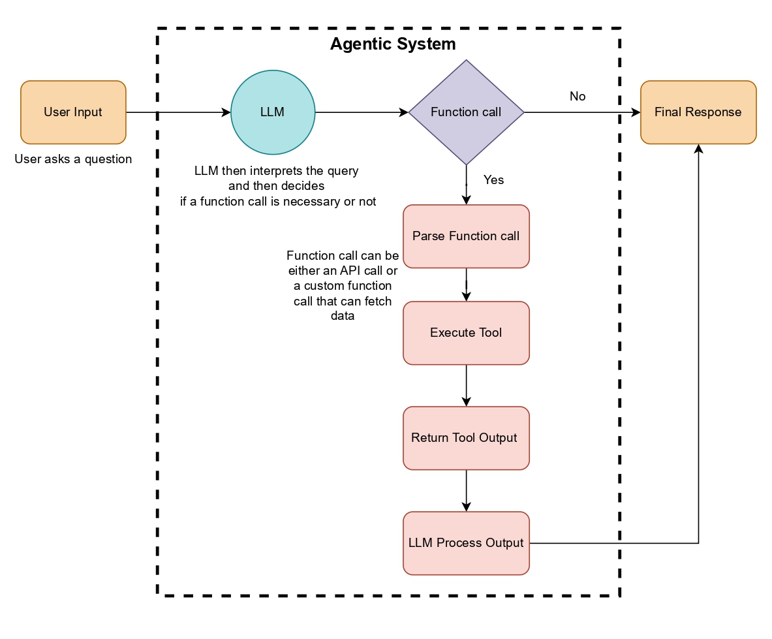
Background
Function Calling in LLMs
Internal Working of Function Calling
Notes:
“Now I will explain how function calling works inside an LLM.
The model itself does not run the function.
It only reads the user message, checks if a tool is needed, selects the right function, and then produces a JSON output describing that function call.”
“This JSON is important.
The backend reads the JSON, converts it into a real API call, and executes it.
So the model only generates the instruction, and the system performs the real action.”
#“Because of this, some researchers say ‘function generation’ is a better term than ‘function calling.’
#But the name ‘function calling’ is still used because the behaviour looks like an actual function call.”
##“Tool selection is based on the list provided by the developer.
##The model looks at the tool name and its description to decide which one fits the user request.
These tools are registered using the tools parameter in the Chat Completions API.”
“There is one limitation.
OpenAI currently supports up to 128 functions in one request.
So tool-heavy systems must plan accordingly.”

Slide 14
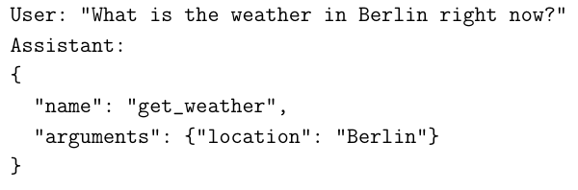
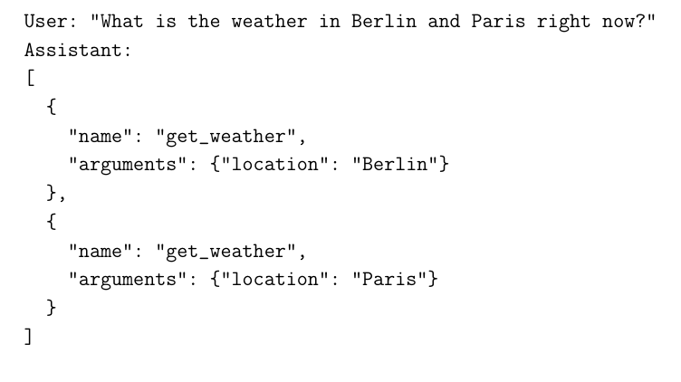
Background
Categories in Function Calling
1. Single-Turn Function Calling:
2. Parallel Function Calling:
Notes:
“There are four categories:
The first is single-turn calling.
Here one user query leads to one function call.
It is simple, independent, and needs no past context.”
“The second is parallel calling.
The model generates multiple function calls at the same time when the request needs several tools.
These calls are independent and can run together.”

Slide 15
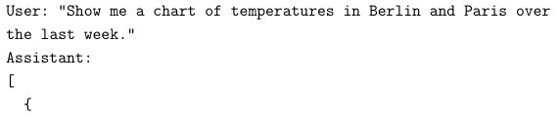
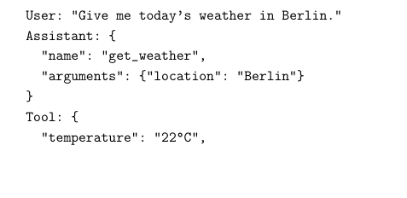
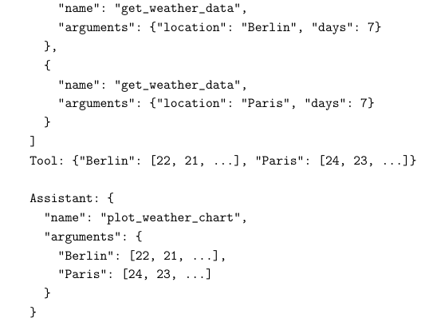
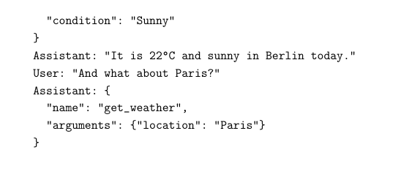
Background
Categories in Function Calling
3. Nested Function Calling:
4. Multi-Turn Function Calling:
Notes:
“The third is nested or sequential calling.
In this case, one function’s output is passed into the next function.
This supports multi-step or compositional workflows.”
“And the fourth is multi-turn calling.
This is the most complex form.
The model mixes normal conversation with tool calls, keeps track of previous turns, and asks for missing information when needed.”

Slide 16
Background
Fine-Tuning Techniques, Approaches and Strategies
What is Fine-Tuning?
Adapts a pre-trained LLM to a specific task using a smaller, targeted dataset. Builds on the model’s general language knowledge to improve performance on specialized tasks.
Supervised Fine-Tuning (SFT)
Uses labeled pairs: each input has a correct output. Base model weights (e.g., from Hugging Face) are adjusted using task-specific examples. Ideal for structured tasks like function calling.
Parameter-Efficient Fine-Tuning (PEFT)
Updates only a small subset of parameters while keeping most of the model weights frozen. Reduces compute and memory cost compared to full fine-tuning.
Notes:
“Fine-tuning adapts a pre-trained model to a specific task using a smaller, targeted dataset.
Within fine-tuning, one common approach is Supervised Fine-Tuning (SFT), where the model learns directly from labeled examples.
In supervised fine-tuning, we use input-output (labeled) pairs.
#Base model weights (e.g., from Hugging Face) are adjusted using task-specific examples.
As models grow larger, full fine tuning becomes expensive, which leads to Parameter-Efficient Fine-Tuning (PEFT) methods.
In PEFT methods, we update only a small part of the model while keeping most of its weights frozen.

Slide 17
methodology
4
Notes:
“With the background ready, let’s walk through the full methodology step by step.”

Slide 18
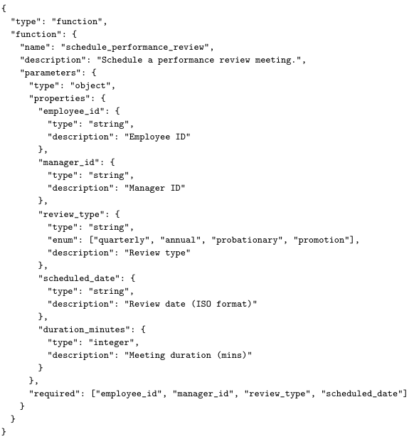
Methodology
Dataset Generation
Dataset foundation
Dataset creation is the first and most important step for fine-tuning LLMs. Focused on enterprise-level scenarios where function calling is common.
Use case design
Created 15 realistic enterprise scenarios across HR, finance, logistics, IT, and support. Scenarios built through brainstorming and AI-assisted tools.
Function generation
Single-Turn: 45 functions (3 per scenario)
Multi-Turn setup: 15 functions (1 per scenario) to keep context manageable.
Example of JSON Schema for
the Function ‘schedule_performance_review’
Notes:
**“Now let’s start with the methodology section. “Dataset creation is the foundation.
I created 15 enterprise scenarios like HR, finance, IT, support, and logistics.
These scenarios match typical enterprise workflows.”
“For single-turn: 45 functions, 3 per scenario.
For multi-turn: 15 functions, one per scenario, because multi-turn requires stable context.”
To show how a function is actually defined in the tools parameter, here is an example from the Human Resources (HR) Management scenario. type -> Always set to "function". It tells the system that this object defines a callable function.
function -> The main container that holds the function’s name, description, and parameters.
Inside the parameter section, the inner ‘type’ is usually set to ‘object’, meaning the function expects a group of input fields.
Type -> Usually "object", meaning the function expects a group of input fields.
Required -> Lists the fields that must be included every time the function is called. If a field isn’t in this list, it’s optional.

Slide 19
Methodology
Dataset Generation
Prompt difficulty types
User queries generated in different difficulty levels: simple, complex, ambiguous, unclear. Helps simulate real-world user behaviour.
Dataset splitting
Final dataset split into 80% train, 10% validation, and 10% test. Training teaches the model; validation tunes it; test measures real-world performance.
Notes:
“User queries were created in different difficulty types: simple, complex, ambiguous, and unclear.
This helps simulate real user behaviour.” “Each user query has a matching correct function call.
All pairs were manually checked to ensure correctness.”
“System prompts, user queries, functions, and ground truth are merged into one conversation entry.
The dataset is split into 80% train, 10% validation, 10% test.” Validation set monitors performance during training, helping to tune hyperparameters and avoid overfitting and test set evaluates the model on un seen data to measure its real-world performance.

Slide 20
Methodology
Model Selection
Models are chosen based on performance, number of parameters, availability of weights for fine-tuning, API access provided by the Institute, accuracy, and effectiveness in tool calling.
Models used in this work:
OpenAI GPT-5 (gpt-5-2025-08-07)
Qwen3-14B (qwen/qwen3-14b)
Llama-3.1-8B-Instruct (meta-llama/llama-3.1-8b-instruct)
Ministral-8B-Instruct-2410 (mistralai/ministral-8b)
In this work, "Instruct" versions of models are used instead of "Base" versions for fine tuning, as they are better suited for conversational and function calling tasks.
These models follow natural instructions more accurately and align well with chat templates such as ChatML and ShareGPT.
Notes:
“Models selected: GPT-5, Qwen3-14B, Llama-3.1-8B-Instruct, and Ministral-8B.
These models were chosen based on their performance, number of parameters, availability of open weights for fine-tuning, the API access provided by the institute, and how well they handle tool calling tasks.
In this work, ‘Instruct’ versions of the models are used instead of the ‘Base’ versions because they follow natural instructions better and align well with chat templates such as ChatML and ShareGPT, which is important for conversational and function-calling tasks.”

Slide 21
Methodology
Fine-Tuning Setup
Framework Choice
Used Unsloth framework for efficient fine-tuning.
Works well on low-VRAM GPUs and supports 4-bit/16-bit quantization.
Fully compatible with QLoRA + BitsAndBytes.
Integrated with Hugging Face Transformers for models, tokenizers, and training scripts.
Supports GGUF, instruct, and base models.
Lightweight and ideal for local / Colab / Kaggle environments.
Supports LLMs, BERT, vision, TTS, and RL models.
Experiments run on NVIDIA A100-80GB GPU with 12 CPU cores.
Single-GPU setup; multi-GPU support still developing for Unsloth.
Notes:
I used Unsloth with QLoRA.
This framework is chosen because it is very efficient for fine-tuning and works well even on low-VRAM GPUs. It supports 4-bit and 16-bit quantization through BitsAndBytes, and it integrates fully with Hugging Face Transformers for loading models, tokenizers, and training scripts.
#Unsloth also supports GGUF models, both instruct and base versions, and it is lightweight enough for local setups, Colab, or Kaggle.
All experiments in this work were done on an NVIDIA A100-80GB GPU with 12 CPU cores in a single-GPU setup, since multi-GPU support in Unsloth is still under development.”

Slide 22
Methodology
Fine-Tuning Setup
Training Workflow
Load dataset.
Load model + tokenizer in 4-bit QLoRA format.
Why QLoRA?
Extends LoRA by combining low-rank adapters with 4-bit or 8-bit weight quantization Enables fine-tuning very large models on single-GPU or consumer hardware.
Example: Llama-65B full fine-tune needs ~780GB; QLoRA reduces it to ~48GB of VRAM.
Apply LoRA adapters instead of updating full weights.
Process the dataset using:
ChatML for single-turn and multi-turn.
Start training.
Save and export the fine-tuned model for inference & evaluation.
Notes:
**“In the training workflow, the dataset is first loaded, followed by the model and tokenizer in a 4-bit QLoRA format.
QLoRA is used because it extends LoRA with 4-bit or 8-bit weight quantization, which allows very large models to be fine-tuned on single-GPU or consumer hardware. #For example, a full fine-tune of Llama-65B needs around 780GB of VRAM, but with QLoRA it can be reduced to about 48GB.
LoRA adapters are applied so that only a small set of parameters is updated instead of the full model weights. The dataset is processed using ChatML formatting for both single-turn and multi-turn examples.
Training is then started, and once completed, the fine-tuned model is saved and exported for inference and evaluation.”**

Slide 23
Methodology
Hyperparameter Tuning
Selecting good hyperparameters is important for stable and accurate fine-tuning.
Manual tuning is slow and often unreliable (error-prone).
Automated tuning tools help search many combinations efficiently.
Tools Used
Optuna (main tool for this study)
Other common tools: Hyperopt, Ray Tune, AutoTrain
Single-Turn Task
Model: Ministral-8B-Instruct-2410
Metric: Validation loss (eval_loss)
Optuna selected the best settings by running multiple
trials and choosing lowest eval_loss.
Multi-Turn Task
Model: Qwen3-14B-unsloth-bnb-4bit
Same process: tune
hyperparameters → pick lowest validation loss.
Notes:
**“Finding the right hyperparameters is important. We can do it manually with trial and error or with an automatic script. To make this efficient, automated tools help search many combinations much faster and more reliably. I used Optuna to test multiple combinations, which is a common tool for hyperparameter tuning along with Hyperopt, Ray Tune, and AutoTrain.
For single-turn, we tuned Ministral-8B, and Optuna selected the best settings by running many trials and choosing the lowest validation loss. For multi-turn, we tuned Qwen-14B, and the same process was used to pick the best hyperparameters based on the lowest validation loss.”**

Slide 24
Methodology
Evaluation Metrics
Single-Turn Evaluation - Standard ML Metrics
Single-Turn Evaluation - Function-Calling Specific Metrics
Accuracy Shows how often the model predicts the correct function call or correctly predicts no call. | Precision Checks how many predicted function calls were actually correct. Measures reliability of positive predictions.
Recall Measures how well the model finds all valid function calls present in the ground truth. | F1 Score Harmonic mean of precision and recall. Useful when both missing calls and predicting wrong calls matter.
Tool Usage Detection Rate | Measures the model’s ability to decide when a tool call is needed vs. when a normal reply is enough.
Tool Selection Robustness | Checks if the model picks the correct tool name after choosing to make a function call.
Parameter Completeness Rate | Measures if the model fills all required parameters correctly. Ensures no missing, extra, or incorrect parameters.
Notes:
“Now let's focus on the evaluation metrics.
“For the single-turn evaluation, I used two groups of metrics.
The first group is the standard machine learning metrics.
Accuracy shows how often the model predicts the correct function call, or correctly predicts that no call is needed.
Precision checks how many of the predicted function calls were actually correct, so it tells us how reliable the positive predictions are.
Recall measures how well the model finds all the valid function calls that exist in the ground truth.
And the F1 score combines both precision and recall.
“The second group focuses on function-calling behaviour.
Tool Usage Detection Rate measures if the model can decide when a tool call is needed, and when a normal reply is enough.
Tool Selection Robustness checks if the model chooses the correct tool name after deciding to use a tool.
And the Parameter Completeness Rate measures if all required parameters are filled correctly, without missing, extra, or incorrect values.
These metrics help us understand how well the model handles the full structure of a function call, not just whether it predicts something.”

Slide 25
Methodology
Multi-Turn Evaluation
Evaluation Metrics
Automated Evaluation
Uses an AST-based checker (Abstract Syntax Tree).
Breaks the output into a structured tree to compare predicted vs. ground truth calls.
Conversation-Level Success Rate (CSR) | Measures if the final tool call matches the ground truth. Checks both correct tool name and all required parameters.
Clarification Handling Rate (CHR) | Measures how often the model asks for missing parameters instead of guessing. Checks if the model completes the tool call correctly after clarification.
Parameter Completeness Rate | Evaluates whether all required parameters are filled correctly. Ensures parameter values are accurate and nothing important is missing.
Notes:
“After looking at the single-turn metrics, For automated evaluation, I designed an AST-based checker.
It breaks each predicted function call into a structured tree and compares it directly with the ground truth.
This makes the evaluation consistent and reliable.”
“For multi-turn evaluation, there are three main metrics.
The first is the Conversation-Level Success Rate.
It checks if the final tool call matches the ground truth, including the correct tool name and all required parameters.
The second is Clarification Handling Rate.
This measures how often the model asks for missing information instead of guessing, and whether it completes the call correctly after clarification.
The third is Parameter Completeness Rate.
It checks whether all required parameters are filled correctly, with accurate values and nothing missing or extra.”

Slide 26
Research findings
5
Notes:
“With the setup complete, let’s look at the results.”

Slide 27
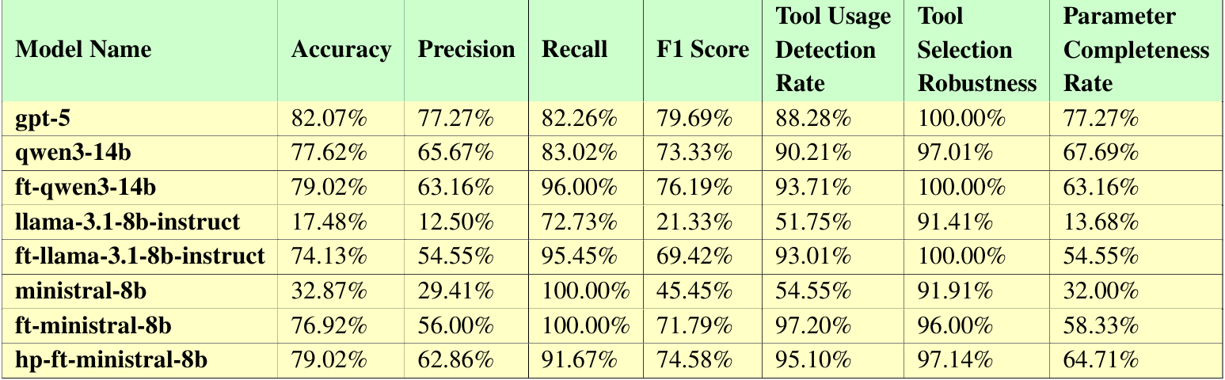
Results
Single-Turn Results
Notes:
“Now we move to the results section, starting with the single-turn evaluation. On this slide you can see the main table that summarizes the performance of all models — baseline, fine-tuned, and hyperparameter-tuned. You can see the prefixes: ft for fine-tuned models and hp for the hyperparameter-tuned model.” and baseline models without any prefixes.
“From the baseline results, we see a clear gap between the models. GPT-5 performs the best with around 82% accuracy, strong precision, and high parameter completeness. Qwen3-14B also performs well with 78% accuracy and stable behaviour. So overall, baselines show that small models need tuning to be useful for function calling.”
**“After fine-tuning, the improvements are very clear. Accuracy and F1 increase by 35–50% across all models. For example: Llama-3.1-8B jumps from 17% to 74%, and Ministral-8B from 33% to 77%. Most important: fine-tuned small models now match or beat larger base models. This shows fine-tuning has a big impact.”**
“Tool-related metrics also improve. Tool Usage Detection and Tool Selection stay very high, around 95–100%. Parameter Completeness improves by 30–40%, but there is still room for improvement.”
“Finally, we applied hyperparameter tuning to the Ministral-8B model. This gave small but meaningful gains: accuracy improves from 77% to 79%, precision increases from 56% to 63%, and parameter completeness rises from 58% to 65%.

Slide 28
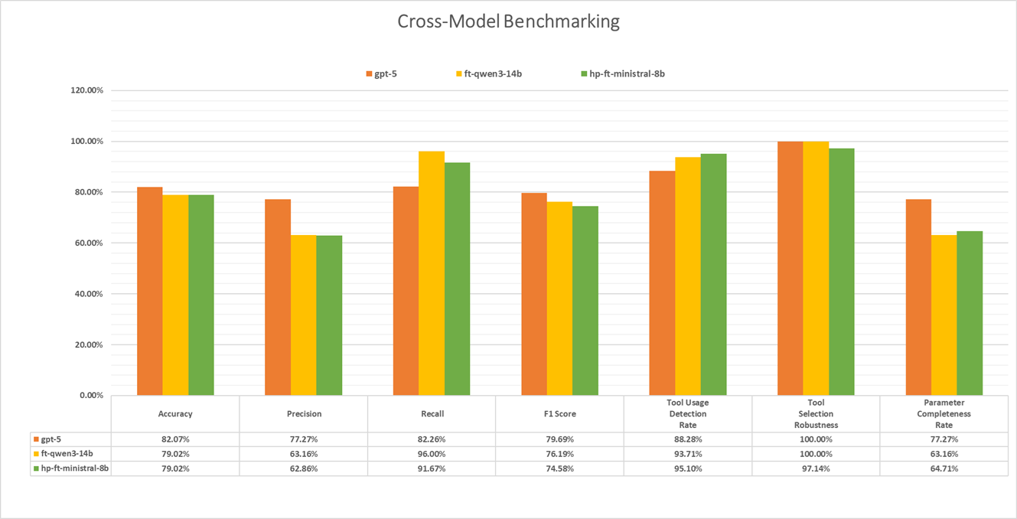
Results
Single-Turn Results
Notes:
“To close the single-turn results, this slide shows the cross-model benchmarking. Here you can see how baselines, fine-tuned models, and hyperparameter-tuned models compare across all metrics.”“
The orange bars represent GPT-5, the yellow bars represent the fine-tuned Qwen3-14B model, and the green bars show the hyperparameter-tuned Ministral-8B model.
GPT-5 performs strongly across most metrics, as expected for a large proprietary model.
But what is important here is that both open-source models come very close, especially the green hp-ft-Ministral-8B.
It matches GPT-5 in several areas and even performs better in recall, tool-usage detection, and stability. This shows that with the right fine-tuning and optimization, smaller open-source models can reach enterprise-level reliability without needing huge models like GPT-5.”

Slide 29
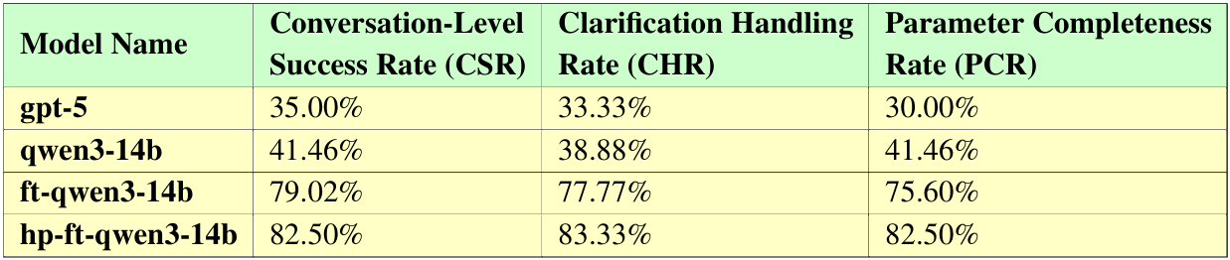
Results
Multi-Turn Results
Notes:
“Now moving to multi-turn results.
“In the baseline comparison, both GPT-5 and Qwen3-14B struggle. GPT-5 reaches around 35% CSR, while Qwen is slightly higher at 41%.
So even strong models fail when the task needs multiple turns and clarifications.”
“After fine-tuning, Qwen3-14B improves sharply. CSR jumps from 41% to 79%, CHR from 39% to 78%, and PCR from 41% to 76%.
This shows the model learns to ask for missing information instead of guessing, and completes tool calls more accurately.”
“With hyperparameter tuning, performance becomes even more stable. The tuned Qwen reaches around 82–83% across all three metrics. So fine-tuning plus optimization makes multi-turn performance reliable and usable in real workflows.”

Slide 30
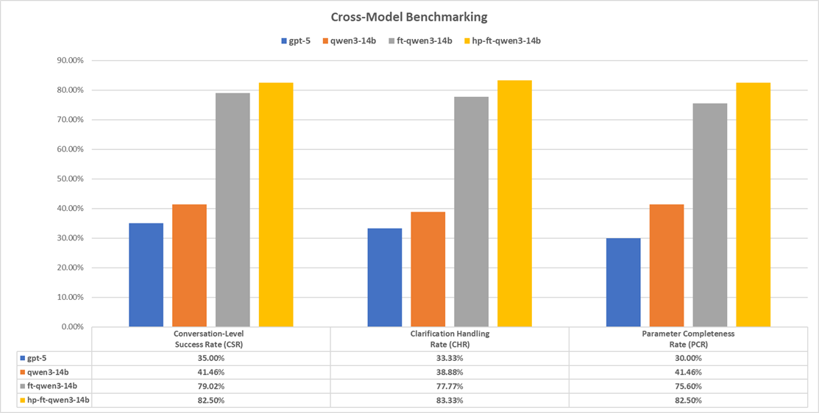
Results
Multi-Turn Results
Notes:
This slide summarises the cross-model benchmarking for multi-turn tasks.
“In this bar chart, the blue bars are GPT-5, orange is base Qwen3-14B, gray is fine-tuned Qwen, and yellow is the hyperparameter-tuned Qwen.
We can see that the yellow model clearly leads across all metrics, reaching around 82–83%. The gray model also performs strong, while both GPT-5 and the base Qwen model stay low, around 30–40%.
This shows that with proper fine-tuning and optimization, a smaller model like Qwen3-14B can even outperform large proprietary models in multi-turn tasks.”

Slide 31
Limitations & Future Work
6
Notes:
“Next, let’s look at the limitations of this study and possible future directions.”

Slide 32
Limitations & Future Work
Study focuses only on single-turn and multi-turn calls.
No evaluation of parallel function calling.
No support for nested / multi-step calls where outputs feed into later steps.
Only QLoRA used for fine-tuning.
Other methods like adapters tuning, prefix tuning, or prompt-based tuning can be explored for better speed, generalization, or stability.
Dataset is synthetic and may not fully reflect real user behaviour.
Limited variety, ambiguity, long-dialogue patterns.
Multi-turn setup does not include:
Intent shifts, overwriting parameters.
Model selection limited to medium and large models.
No testing on 1B-3B lightweight models or even smaller that might be important for edge devices.
Notes:
**“This study focuses only on single-turn and multi-turn function calling. Parallel calls are not evaluated, and nested or multi-step tool calls are not included.
For fine-tuning, only QLoRA is used. Other methods like adapter tuning, prefix tuning, or prompt-based tuning can be tested to compare efficiency and generalization.
The dataset is synthetic, so it may not fully reflect real user behaviour. It does not cover long dialogues, intent shifts, or parameter overwriting.
intent shifts - When the user completely changes the goal of the conversation mid-way.
Example:
User: "Book a flight to Paris." [Assistant starts gathering details] User: "Actually, nevermind. What's the weather in Tokyo?" → The model should drop the flight booking and answer the new weather question.
parameter overwriting - When the user corrects or changes a detail they provided earlier.
Example:
User: "Schedule a meeting for 3 PM." [Assistant acknowledges] User: "Sorry, I meant 4 PM." → The model must use the new time (4 PM) and ignore the old one (3 PM).
Model selection is also limited to medium and large models. We did not test smaller 1B-3B models that are suitable for edge deployment.
Future work can extend the evaluation to parallel and nested calls, explore other fine-tuning approaches, use more realistic datasets, and include lightweight models.”**

Slide 33
Conclusion
7
Notes:
“Finally, let me conclude the main findings of this work.”

Slide 34
Conclusion
Study gives a clear evaluation of function calling in LLMs for both single-turn and multi-turn tasks.
Fine-tuning, mainly with QLoRA, improves accuracy and completeness of function calls.
Hyperparameter tuning plays an important role in model stability and better generalization.
Well-tuned smaller models can match or even exceed larger models for function-calling tasks.
The work provides a solid base for building more stable and practical LLM-based agent systems for enterprise use case.
Notes:
“To conclude, this study provides a clear evaluation of function calling in LLMs for both single-turn and multi-turn tasks.
Fine-tuning with QLoRA improves accuracy and helps the model generate more complete and correct function calls.
Hyperparameter tuning also plays an important role. It makes the model more stable and improves generalization.
We see that smaller well-tuned models can match or even surpass larger models for function-calling tasks.
Overall, this work gives a strong base for building stable and practical LLM-based agent systems for real enterprise use cases.”

Slide 35
Many thanks for your attention
Notes:
“Thank you for your attention. I am happy to take your questions.”

